Slide 1

Module 6: Monitoring Resource Use

Slide 2

General Information
Website: www.rc.colorado.edu
Documentation: https://curc.readthedocs.io
Helpdesk: rc-help@colorado.edu
2
2

Slide 3
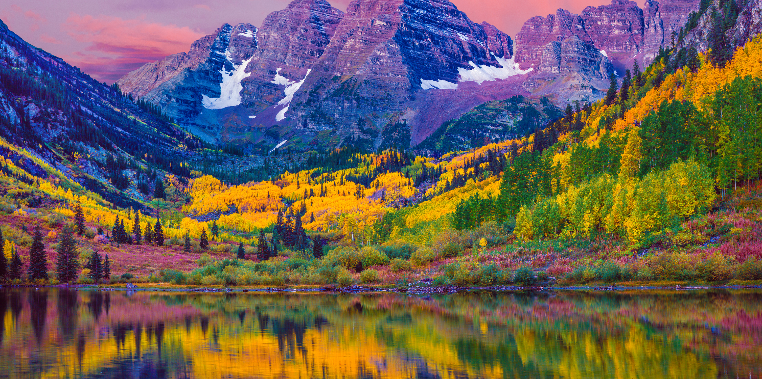








Meet the User Support Team
Layla Freeborn
Brandon Reyes
Andy Monaghan
Michael Schneider
John
Reiland
Dylan Gottlieb
Mohal Khandelwal
Ragan
Lee
3

Slide 4
Learning Objectives
Calculate your resource usage/consumption
View average wait times in the CURC queues
Find your relative "priority”
Check the efficiency of your research workflows
4

Slide 5
Overview
1
2
slurmtools
XDMoD
5

Slide 6

Overview
1
2
slurmtools
XDMoD
6
Notes:
Slurmtools – monitor your jobs and SU’s
XDMoD – observe jobs on the cluster

Slide 7
The slurmtools Module
Available commands
jobstats
A module that loads a collection of functions to assess recent usage statistics
seff
suacct
$ module load slurmtools
seff-array
suuser
levelfs
7

Slide 8
Job Metrics
jobstats
seff
suacct
seff-array
suuser
levelfs
8

Slide 9

jobstats
jobid
jobname
partition
qos
account
cpus
state
start-date-time
elapsed
wait
$ jobstats $USER <# Days>
9

Slide 10
seff
$ seff <jobid>
10

Slide 11
seff
Job ID: 12345
Cluster: alpine
User/Group: ralphie/ralphiepgrp
State: COMPLETED (exit code 0)
Nodes: 1
Cores per node: 4
CPU Utilized: 01:00:07
CPU Efficiency: 25.00% of 04:00:28 core-walltime
Job Wall-clock time: 01:00:07
Memory Utilized: 21.14 MB (estimated maximum)
Memory Efficiency: 0.15% of 13.59 GB (3.40 GB/core)
$ seff <jobid>
11

Slide 12
seff
Job ID: 12345
Cluster: alpine
User/Group: ralphie/ralphiepgrp
State: COMPLETED (exit code 0)
Nodes: 1
Cores per node: 4
CPU Utilized: 01:00:07
CPU Efficiency: 25.00% of 04:00:28 core-walltime
Job Wall-clock time: 01:00:07
Memory Utilized: 21.14 MB (estimated maximum)
Memory Efficiency: 0.15% of 13.59 GB (3.40 GB/core)
$ seff <jobid>
Total CPU Time
12
Notes:
CPU Utilized refers to the total amount of time the allocated CPU cores were used.

Slide 13
seff
Job ID: 12345
Cluster: alpine
User/Group: ralphie/ralphiepgrp
State: COMPLETED (exit code 0)
Nodes: 1
Cores per node: 4
CPU Utilized: 01:00:07
CPU Efficiency: 25.00% of 04:00:28 core-walltime
Job Wall-clock time: 01:00:07
Memory Utilized: 21.14 MB (estimated maximum)
Memory Efficiency: 0.15% of 13.59 GB (3.40 GB/core)
$ seff <jobid>
Max Memory Used
13
Notes:
Memory Utilized is not a total, but rather the maximum amount of RAM memory used by the job.

Slide 14
seff-array
$ seff-array <jobid>
14

Slide 15
seff-array
Allocated Resources Per Job
$ seff-array <jobid>
Job Information
ID: 12345678
Name: job_array.sh
Cluster: alpine
User/Group: ralphie/ralphiepgrp
Requested CPUs: 1 cores on 1 node(s)
Requested Memory: 1.88G
Requested Time: 00:10:00
15

Slide 16
seff-array
Allocated Resources Per Job
$ seff-array <jobid>
Average Job Efficiency
Job Status
COMPLETED: 3
-----------------------------------
Finished Job Statistics
Average CPU Efficiency 0.10%
Average Memory Usage 0.00G
Average Run-time 42.00s
16

Slide 17
seff-array
Allocated Resources Per Job
$ seff-array <jobid>
Average Job Efficiency
CPU Efficiency (%)
--------------------
+0.00e+00 - +1.00e+01 [2] █████████
+1.00e+01 - +2.00e+01 [1] ███
+2.00e+01 - +3.00e+01 [0]
[…]
+8.00e+01 - +9.00e+01 [0]
+9.00e+01 - +1.00e+02 [0]
Average Job Efficiency
17

Slide 18
Job Metrics, Continued
jobstats
seff
suacct
Job Metrics
seff-array
suuser
levelfs
18

Slide 19
Job Priority
jobstats
seff
suacct
Job Metrics
seff-array
suuser
levelfs
19

Slide 20
Priority
A job’s priority determines its position in the queue.
A job’s priority is based on multiple factors, including:
FairShare score
Age
Resources requested
Job size
QOS
20

Slide 21
levelfs
> 1
$ levelfs <username>
High Priority
LevelFS for user ralphie and institution ucb:
Account LevelFS_User LevelFS_Inst
-----------------------------------------------------
ucb-general 2.015951 0.943096
< 1
Low Priority
21

Slide 22



Service Units
SU = x
Service units (SUs), sometimes called “core hours”, reflect the processing that a core performs in one hour modified by some scaling factor
22

Slide 23
suuser
How many Service Units (SUs) have I used?
$ suuser <username>
SU used by user ralphie in the last 30 days:
Cluster |Account |Login |Proper Name|TRES Name|Used|
alpine |ucb-general|ralphie|R. Buffalo |billing |283 |
23

Slide 24
suacct
Who is using all the SUs on my group’s account?
$ suacct <account / allocation>
SU used by account ucb123_asc1 in the last 30 days:
Cluster|Account |Login |Proper Name|TRES Name|Used|
alpine |ucb123_asc1| | |billing |5802|
alpine |ucb123_asc1|ralphie|R. Buffalo |billing |5802|
24

Slide 25
Allocations
An allocation is a way for us to specify your cut of Alpine’s computational resources.
25

Slide 26
general vs projects
ucb-general (20%)
The ‘general’ and ‘project’ accounts are structured such that your jobs are likely to have a higher priority if they are running in the ‘project’ account.
ucb-projects (80%)
26
Notes:
The ‘general’ and ‘project’ accounts are structured in a way such that your jobs are likely to have a higher priority if they are running in the ‘project’ account.
ucb-general
rmacc-general
amc-general
csu-general

Slide 27



Alpine Allocation Tiers (CU Boulder)
Trailhead
Automatic with a CURC account.
~couple thousand SUs in ucb-general
Does not expire
ucb-general
ucb-projects
Ascent
Peak

Slide 28
Ascent vs Peak Allocations
Ascent
Peak
350,000* SUs over 12 months
Quick approval process
Easy to renew each year
Size- 350,000 SUs over 12 months, limit of 1,400,000 SUs per research group/PI
Required info- Complete Ascent Allocation application form
Approval process- quick, no review by allocations committee
Renewal- annual, complete renewal form
Up to 6,000,000 SUs over 12 months
Detailed review of past jobs
Renewal must justify size
* Max 1.6M per Research Group
28

Slide 29
Ascent Allocations (RMACC)
Ascent
100,000* SUs over 12 months
Quick approval process
Easy to renew each year
* Max 400K per Research Group
29

Slide 30
Using Your Allocation
Allocations are referred to as accounts in Slurm’s documentation and are indicated by the --account directive:
#SBATCH --account=<your allocation name>
or
sbatch --account <your allocation name> yourjob.sh
30

Slide 31

XDMOD
31

Slide 32
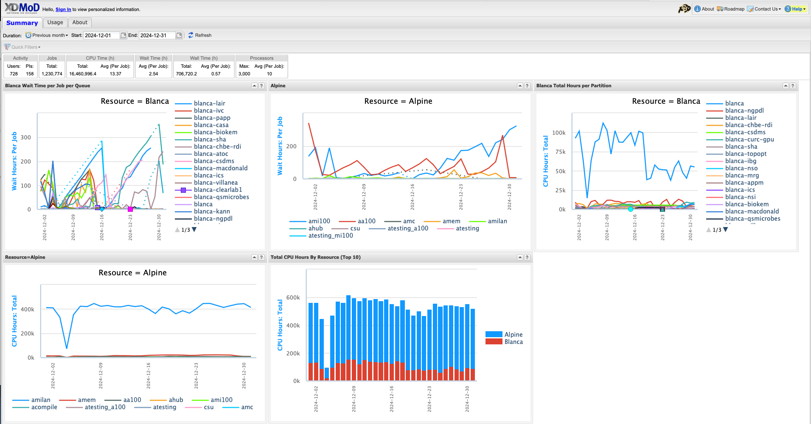
XDMoD
https://xdmod.rc.colorado.edu/
32
Notes:
XDMoD is a web portal for viewing metrics at the system, partition, and user levels.

Slide 33
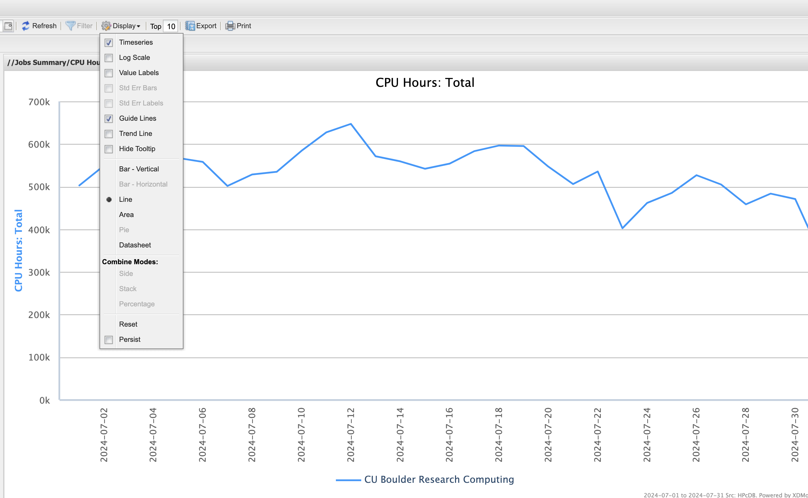
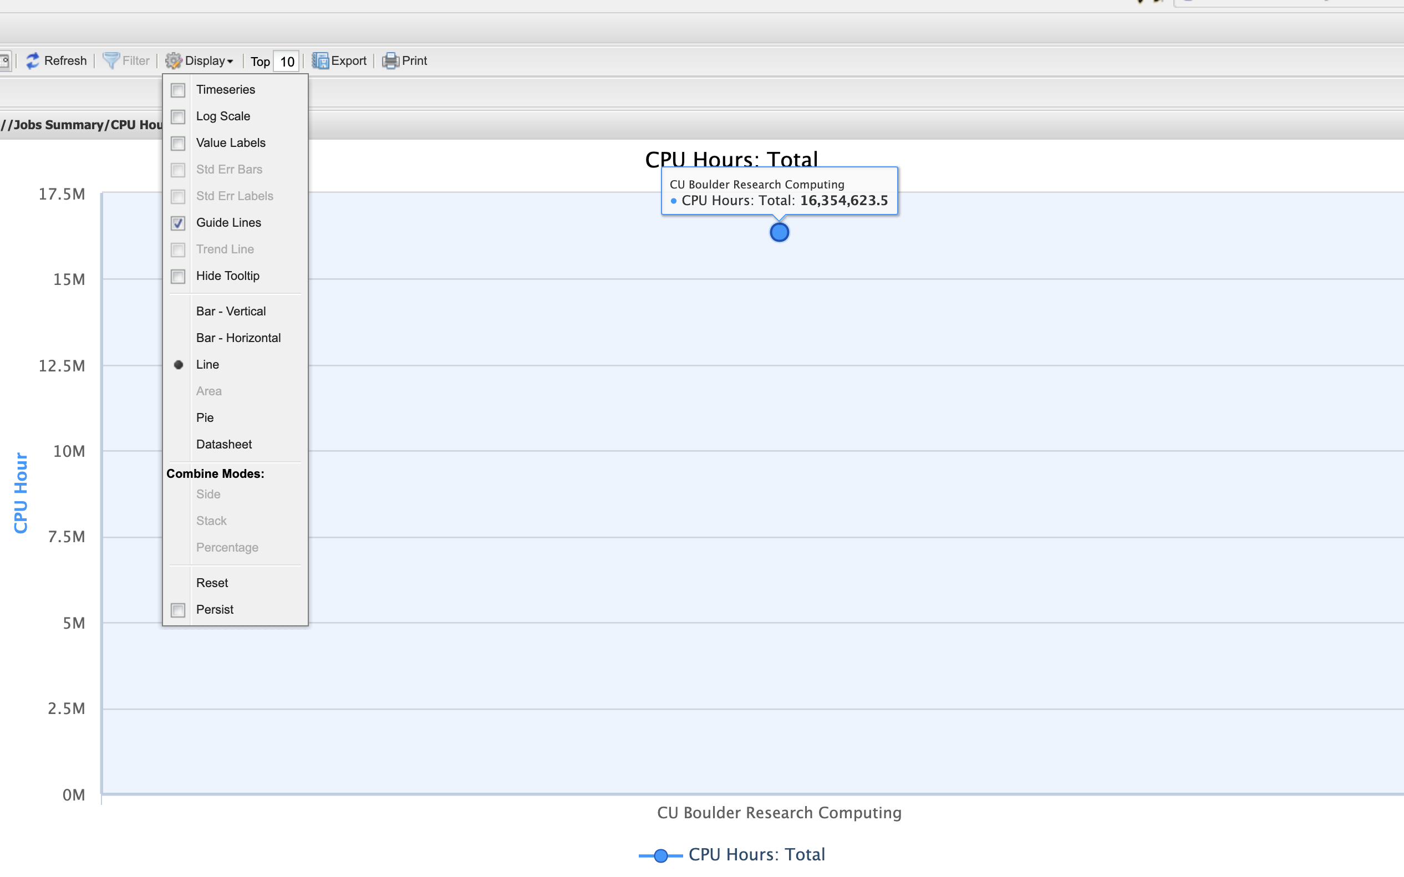
XDMoD Display Menu Defaults
Display Menu: timeseries checked (default)
Display Menu: timeseries unchecked
33

Slide 34
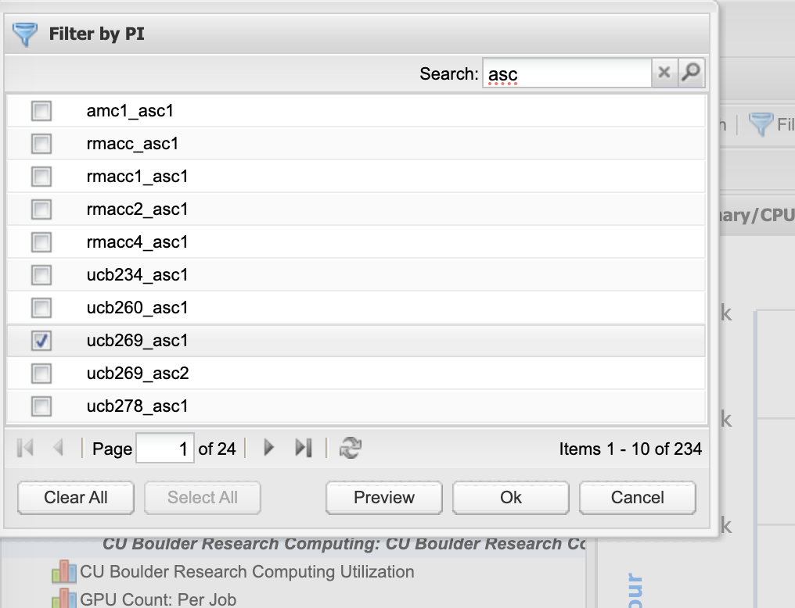
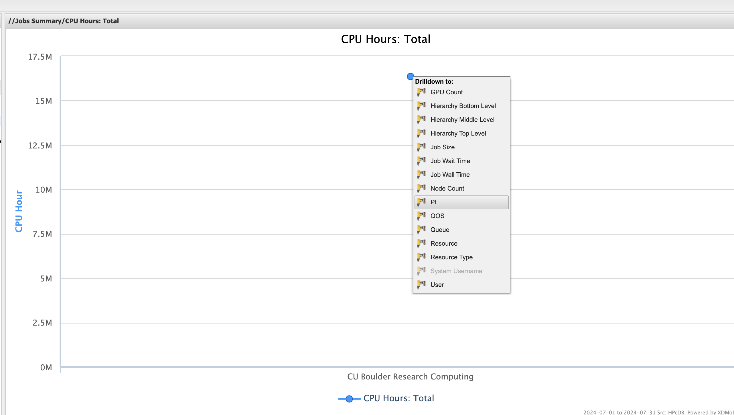
XDMoD Drilldown and Filter
Click on a data point to see Drilldown menu
(PI = Slurm allocation)
Filter and search
34

Slide 35

Feedback Survey
http://tinyurl.com/curc-survey18
35

